Slide 1
Input/Output Interfaces

Slide 2
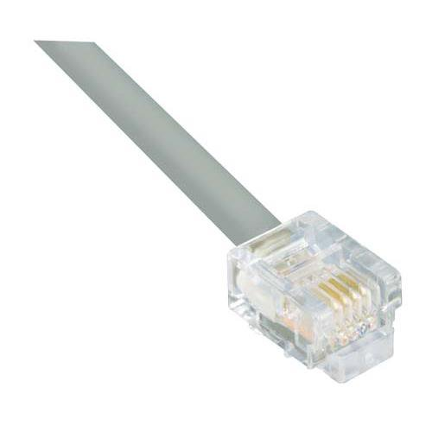
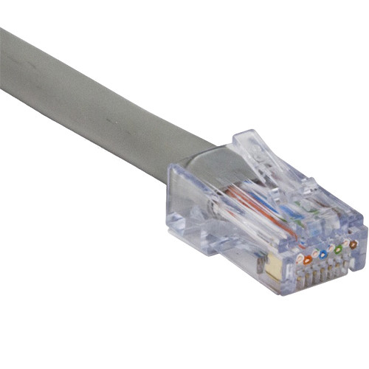
Input/Output Interfaces
Wired Networking Devices
RJ-11
Telephone connector
Dial-up access
RJ-45
Ethernet port
Most common network cable
RJ-11
6 pins
RJ-45
8 pins

Slide 3
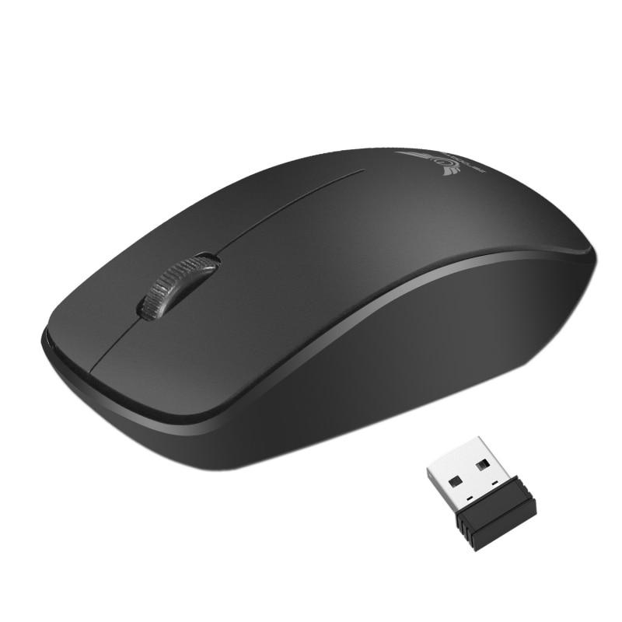

Input/Output Interfaces
Wireless
Bluetooth
Short wave radio waves
Range is around 100m
2.402 - 2.48 GHz
NFC
Very short wave radio
About 4cm
Commonly used for smartphones with credit cards
Bluetooth wireless mouse
Smartphone credit card readers use NFC, like Apple Pay

Slide 4
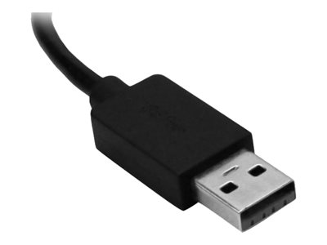
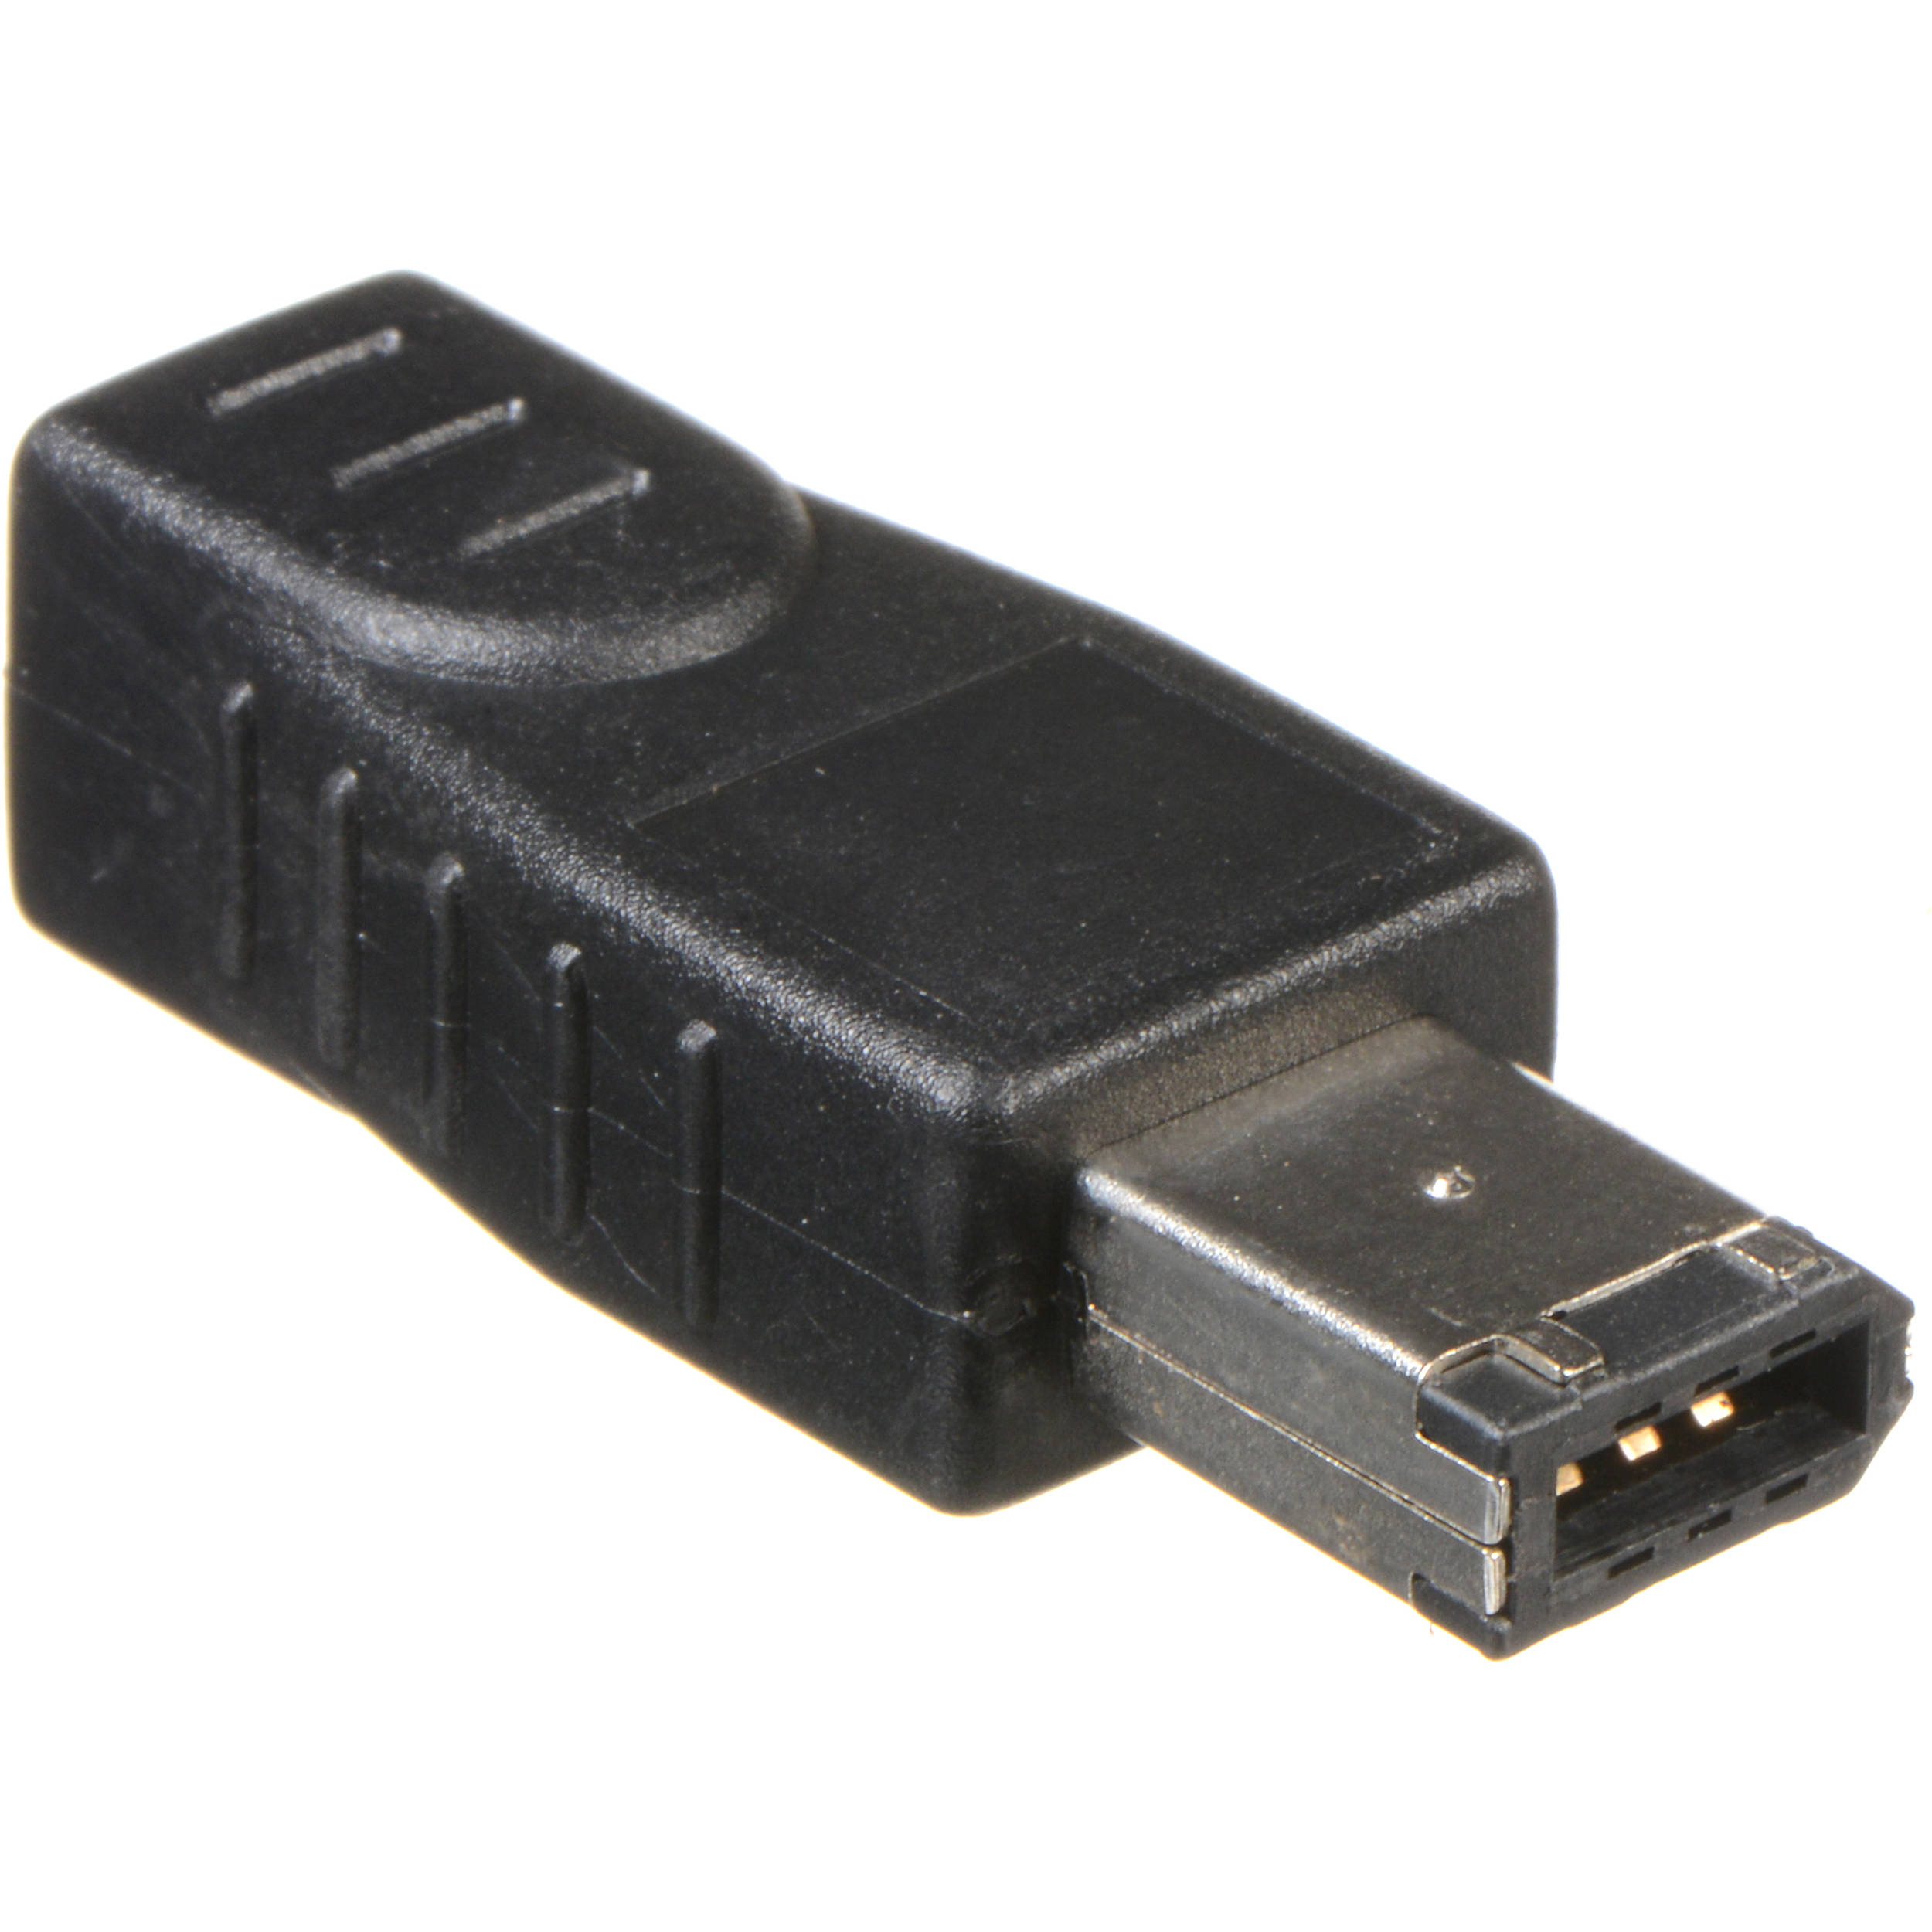
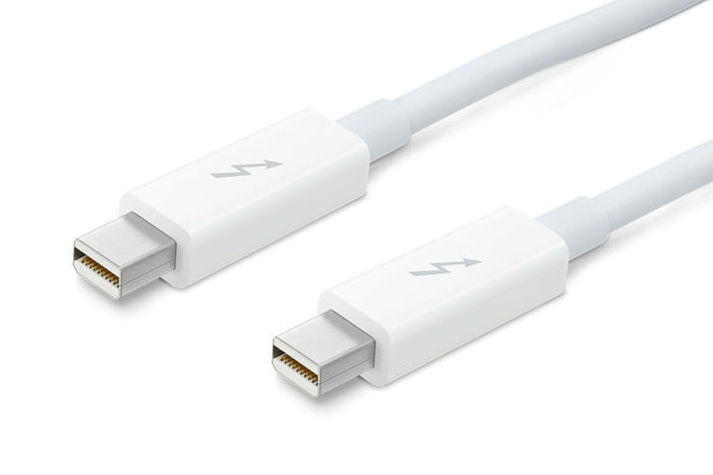
Input/Output Interfaces
Wired peripheral device connections
USB
USB 2.0: up to 480 Mbps
USB 3.0: up to 5 Gbps
USB 3.1: up to 10 Gbps
FireWire (IEEE 1394)
Apple devices
Up to 800Mbps
Thunderbolt
Apple devices
Thunderbolt 3: up to 40 Gbps

Slide 5
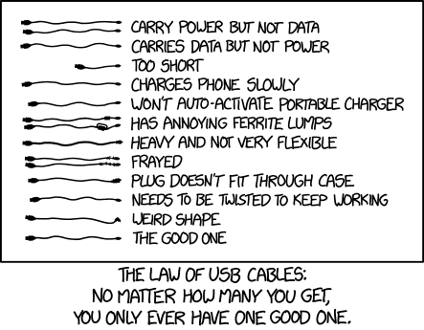
Law of USB Cables
Source: https://xkcd.com/1892/

Slide 6


Input/Output Interfaces
Wireless peripheral device connections
Bluetooth
Built into computer
Up to 100m
Up to 2Mbps
RF
Stands for Radio Frequency
Depends on the device
Bluetooth is an example of RF

Slide 7
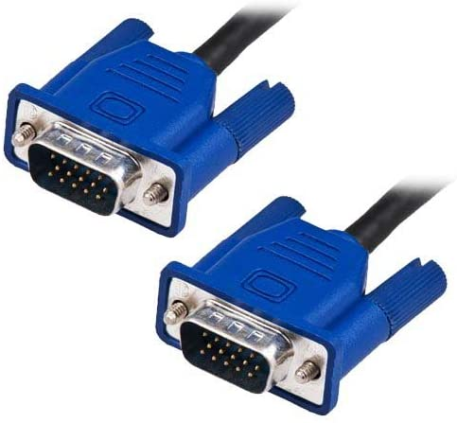
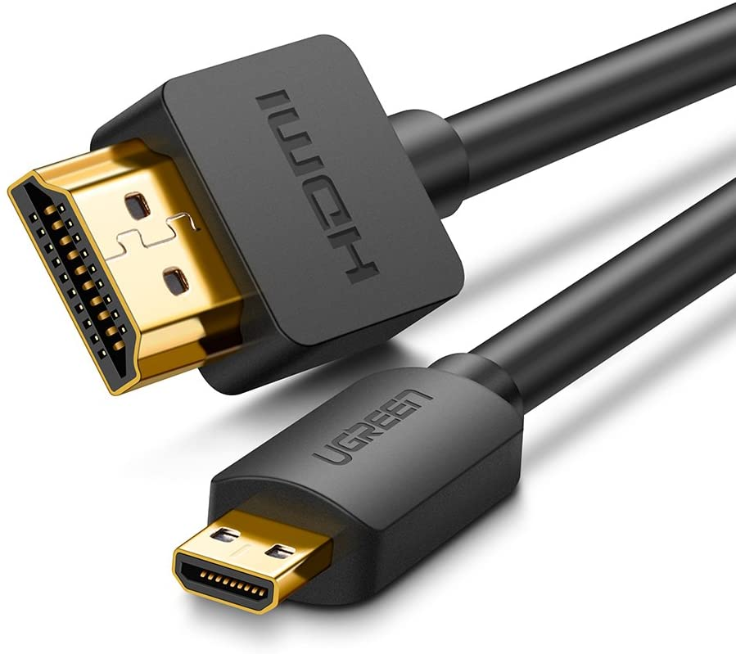
Input/Output Interfaces
Graphical Devices
VGA
15-pins
Analog signal
No audio
Up to 691.2 Mbps
HDMI
19-pins
Digital Signal
Can carry audio
Up to 18 Gbps

Slide 8
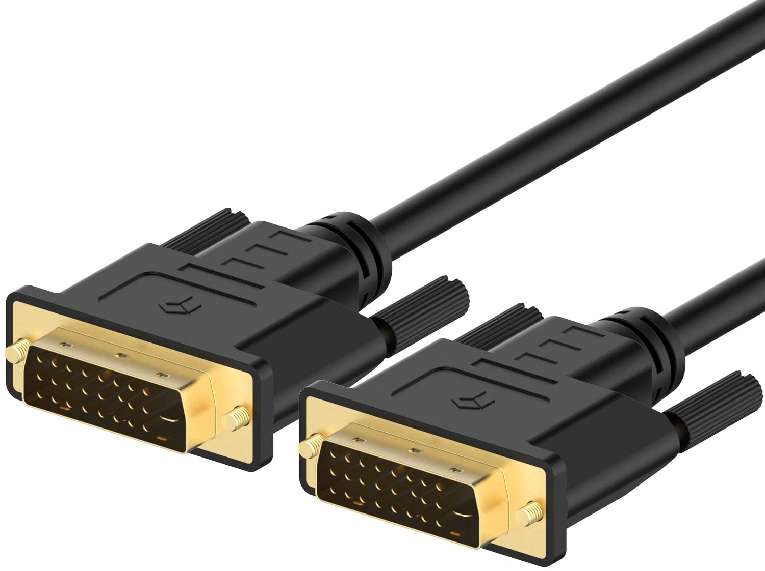
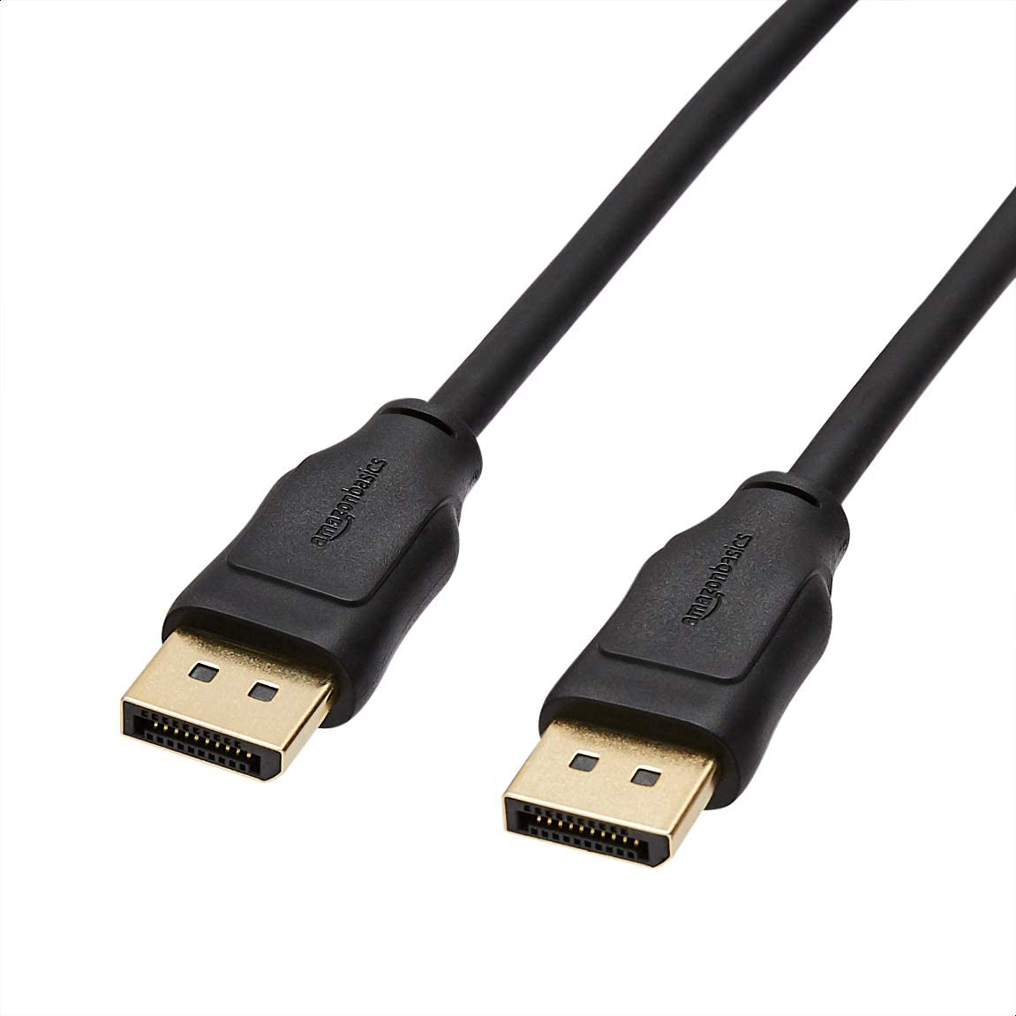
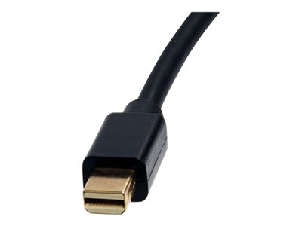
Input/Output Interfaces
Graphical Devices
DVI
Different number of pins
Digital and/or Analog signal
Can send audio
Up to 7.92 Gbps
DisplayPort
20-pins
Digital signal
Can send audio
Up to 77.37 Gbps
Also a smaller Mini-DisplayPort

Slide 9
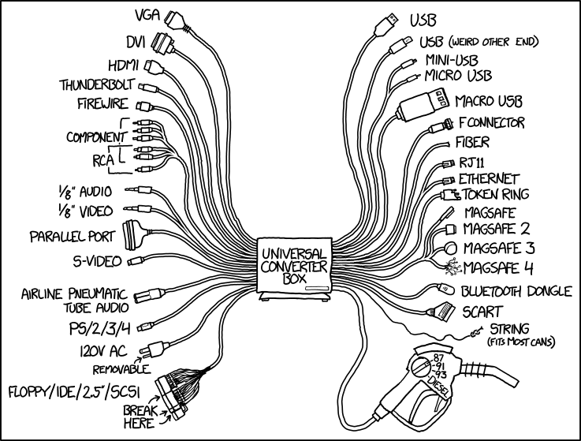
The Universal Converter Box
Source: https://xkcd.com/1406/

